Slide 1

Luis Avila, Sam Prisco, Jalen Terrel-Hart, Ethan Olson, Quinton Birkhofer

Slide 2
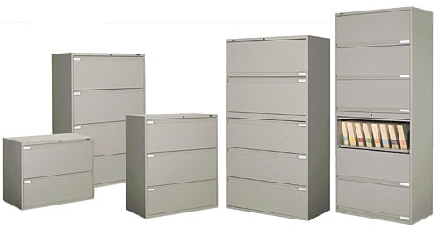

Problem
Keeping track of patient information
Organization of files in Mary Greenley
Tracking patient and doctor information
Physical copies and datasheets
Cybersecurity issues
Notes:
Luis talks in this slide

Slide 3
How will our database help Mary Greenley?
Improve patient information
Better access to their information in an efficient manner
Increase efficiency with hospital information sets and files
Improved information across departments using same information files
Efficient Space Utilization
More space for more important information and storage
Notes:
Luis talks in this slide

Slide 4
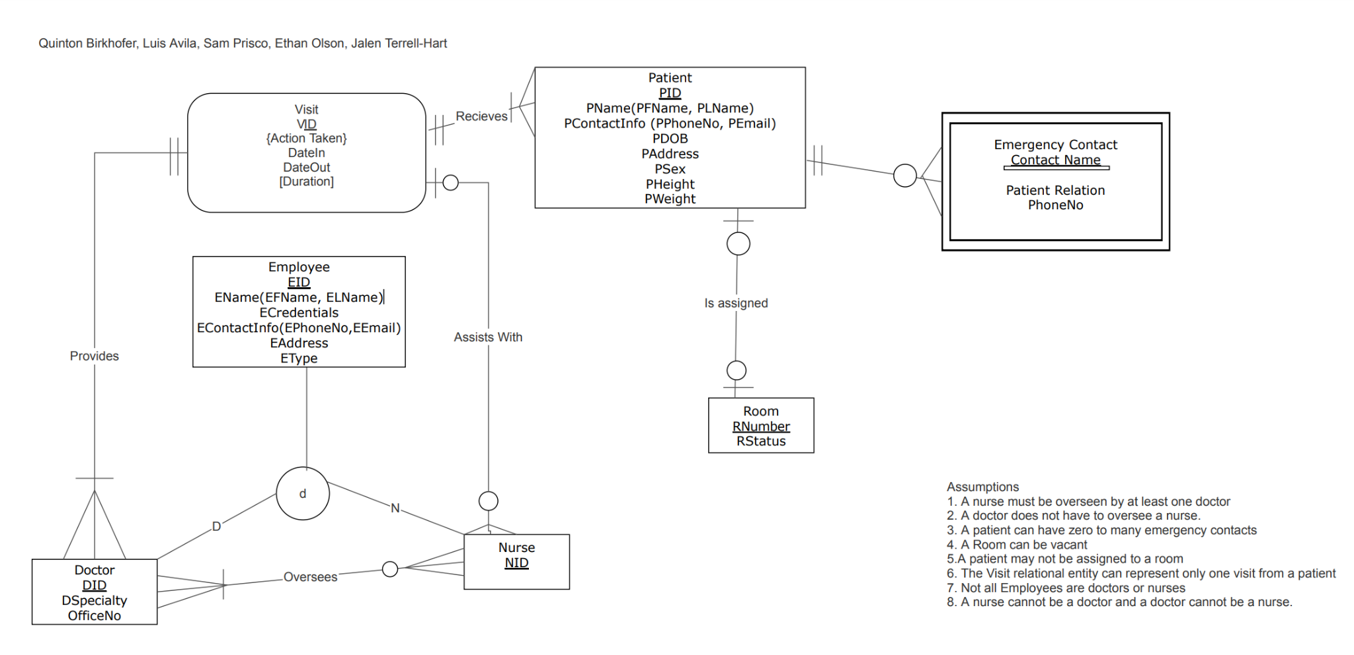
ER Diagram
Notes:
Ethan

Slide 5
Our Assumptions
1. A nurse must be overseen by at least one doctor
2. A doctor does not have to oversee a nurse.
3. A patient can have zero to many emergency contacts
4. A Room can be vacant
5.A patient may not be assigned to a room
6. The Visit relational entity can represent only one visit from a patient
7. Not all Employees are doctors or nurses
8. A nurse cannot be a doctor and a doctor cannot be a nurse
Notes:
Ethan

Slide 6
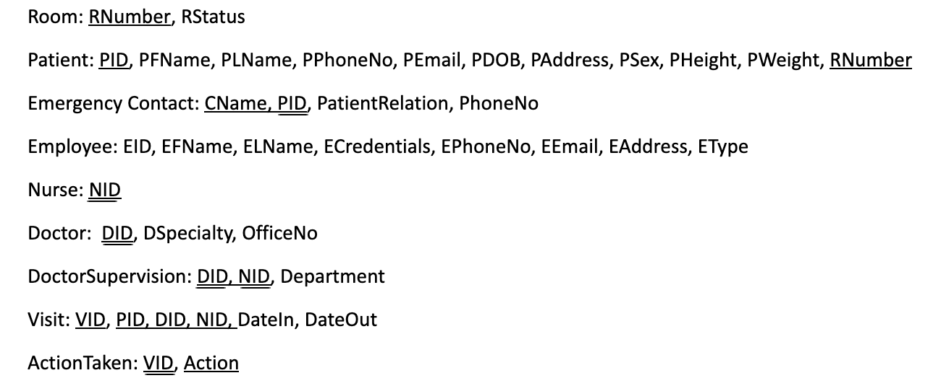
Tables
Notes:
Ethan

Slide 7
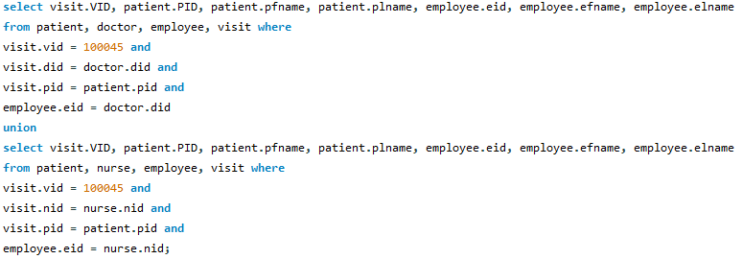

SQL Queries
Scenario: Select Display the Doctor, Nurse, and Patient names involved in a visit.
Impact: This can help with contact tracing and employee accountability
Notes:
Sam

Slide 8
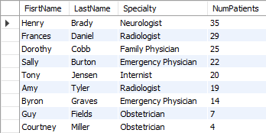
SQL Queries
Scenario: Count the number of patients each doctor sees and display their specialty.
Impact: This can help managers determine which doctors may be over or underworked.
Text
Select employee.efname as FisrtName, employee.elname as LastName, doctor.dspecialty as Specialty, count(distinct visit.PID) as NumPatients
From employee, doctor, visit
Where doctor.did = visit.did and
doctor.did = employee.eid
group by doctor.did
order by -count(distinct visit.PID);
Output
Notes:
Sam

Slide 9
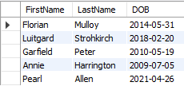
SQL Queries
Scenario: Find all of the patients who were born in this hospital
Impact: This can help with recollection of historical data for patient and physician use.
Text
Select patient.pfname as FirstName, patient.plname as LastName, patient.PDOB as DOB
From patient, visit
Where patient.PID = visit.PID and
patient.PDOB = visit.DateIn;
Output

Slide 10
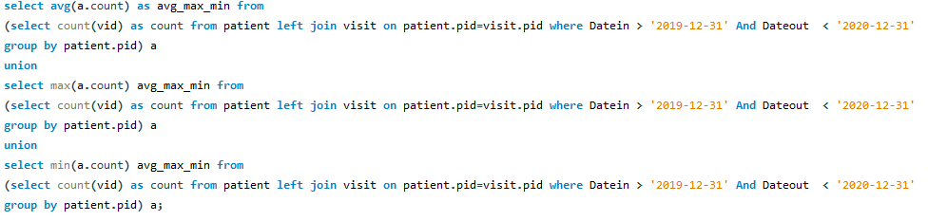

SQL Queries
Scenario: Display the average max and min of number of times a single patient would visit in the specific time period
Impact: To determine how many times a person visits the hospital in a given year/month/day.
Text
Output
Notes:
Quinton

Slide 11
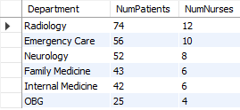
SQL Queries
Scenario: Find out the number of patients and nurses a department has.
Impact: The managers can check if there are enough nurses in each dept. to account for the number of patients.
Text
Output
Select Doctorsupervision.department as Department, count(distinct visit.PID) as NumPatients, count(distinct doctorsupervision.NID) as NumNurses
from doctorsupervision, visit where
doctorsupervision.nid = visit.nid
group by doctorsupervision.department
order by -count(distinct visit.PID);
Notes:
Quinton

Slide 12
Summary
Problems we faced
Coordination
Problems with database
Solving Queries
Notes:
Quinton

